Slide 1
The business case
Is it worth doing, and what would change my mind?
Applied AI and Automation | Session 11 of 12
KLAi Professional Learning | Jotham Martin Wambi
Notes:
Welcome back. Start with your question from last time: what would your chosen route cost in the first year, in hours and in shillings?
Today you answer it, and then ask the bigger question: is this task worth automating, in shillings?
You will build a costed case from the numbers you measured in Session 8, and you will write down what would change your mind.

Slide 2



Today in one view: what you will leave with
By the end of today you will have
A costed business case for your own task, built from the numbers you measured in Session 8
A payback, a 12-month net, a risk haircut and a low, base and high view
Stop rules, and a one-page summary the owner of the business can decide from in two minutes
Notes:
Here is what you leave with. A costed workbook for your own task, with payback and a twelve month net. A haircut for risk and a low, base and high view. Stop rules written as numbers. And a one page summary that the owner of the business can decide from in two minutes. Forty-five of today's minutes are yours.

Slide 3
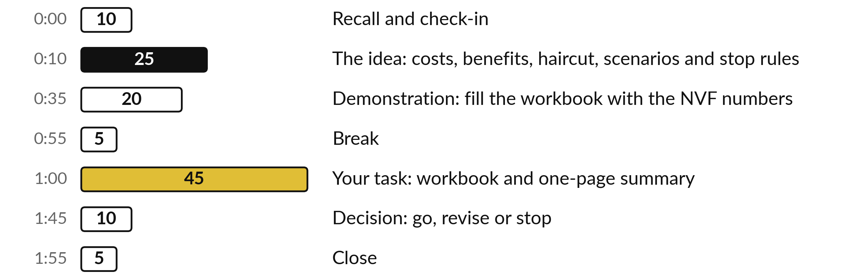
Your two hours: 45 minutes are your own work
45 of the 120 minutes are yours: your numbers, your costs, your decision.
Notes:
Three parts take most of the time. Twenty-five minutes of ideas on costs, benefits, the haircut, the three scenarios and stop rules. Twenty minutes where I fill the workbook live with the Nile Valley Foods numbers. After the break you have forty-five minutes on your own task, in three blocks of fifteen minutes.
The last ten minutes are for your decision: go, revise or stop.

Slide 4

Three questions from last time
1. Name three things you ask a vendor before you sign.
2. What are the three routes when you need a capability?
3. A proposal promises industry-leading accuracy. What do you ask for?
Answer aloud first. Then we check together.
Notes:
Three quick questions from Session 10. Answer aloud first, and then we check together. It is a warm-up to bring last time back.
Question one. Name three things you ask a vendor before you sign. Take a moment.
A good answer is this. Any three of: where the data is stored and who can see it; whether it trains on your data; renewal terms and a price cap; how you exit and get your data back; references; a monthly usage cap; who carries the exchange-rate risk.
Question two. What are the three routes when you need a capability? Say it to yourself first.
A good answer is this. Build it yourself, buy it, or partner with someone.
Question three. A proposal promises industry-leading accuracy. What do you ask for? Think about your own task as you answer.
A good answer is this. A measured error rate on documents like yours, and your own test on a sample.
If an answer was missing, your own task card or last workbook page has it. Now to today.

Slide 5




Words we use today
Word | What it means
Payback | The number of months the monthly net takes to repay the one-off cost.
Loaded hourly cost | Pay plus employer contributions and benefits, divided by hours worked. It is what an hour of staff time costs the company.
Haircut | The share of the benefit you choose not to count, because estimates are rarely exact.
Sensitivity | Trying a low, base and high version of your numbers to see whether the answer changes.
Stop rule | A number written in advance that tells you to stop or revise.
Notes:
Five words for today. I give the plain meaning of each, and we use every one of them before the end of the session.
Payback. The number of months the monthly net takes to repay the one-off cost.
Loaded hourly cost. Pay plus employer contributions and benefits, divided by hours worked. It is what an hour of staff time costs the company.
Haircut. The share of the benefit you choose not to count, because estimates are rarely exact.
Sensitivity. Trying a low, base and high version of your numbers to see whether the answer changes.
Stop rule. A number written in advance that tells you to stop or revise.

Slide 6
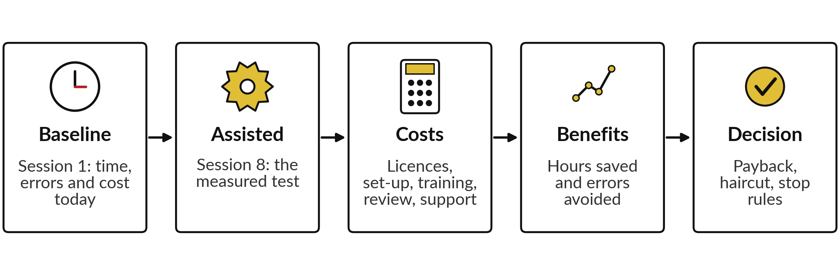
A business case turns your
measured test into money
You already hold the first two steps. Today you add the money.
Notes:
Today's question is whether the task is worth doing and what would change your mind. A business case takes two things you already hold: the baseline from Session 1 and the measured test from Session 8. We put money on both sides: costs, benefits and payback, then a haircut for risk, then stop rules.
Why bother?
Gartner forecasts that over 40% of agent projects will be cancelled by 2027. That is a forecast for large global firms, and one commonly cited reason is unclear value. A short, honest case is the answer to that. It does not need to be perfect. Tell me now which number you are least sure of.

Slide 7







Costs: five lines, and review time never goes away
Cost line | Kind | NVF amount (UGX)
Tool licences | Monthly | 60,000
Set-up time, 12 hours | One-off | 360,000
Training, 4 hours | One-off | 120,000
Review time, 4 runs of 20 minutes | Monthly | 40,000
Support and maintenance, 1.5 hours | Monthly | 45,000
Other: switching, an adviser | Either | 0
Total | Once and monthly | 480,000 once; 145,000 a month
Hours cost UGX 30,000 each (NVF figure, invented). If you buy, use the vendor's first-year total.
Notes:
These are the cost lines in the workbook, with the Nile Valley Foods figures. Licences each month. Set-up and training once. Review time every month: four runs of twenty minutes. It never goes away, so never set it to zero. Total: UGX 480,000 once and UGX 145,000 each month.
Hours use the loaded hourly cost: pay plus employer contributions and benefits, divided by hours worked. For example, UGX 4,500,000 a month plus UGX 500,000 is UGX 5,000,000, and over 160 hours that is about UGX 31,250 an hour. NVF rounds to UGX 30,000. If you buy or partner, put the vendor's first-year total in these lines.

Slide 8
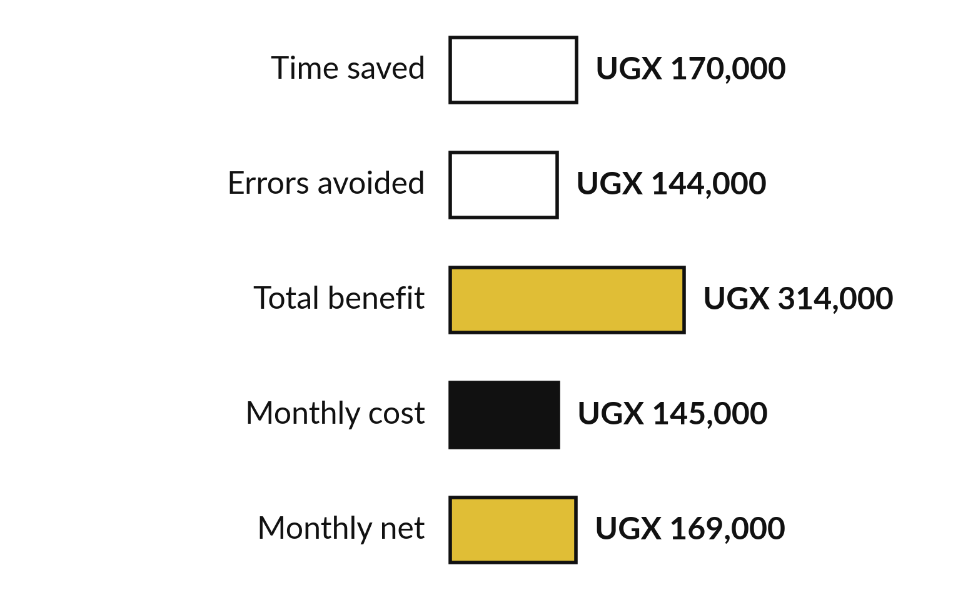
Benefits: count what you
measured, and write down the rest
Count hours and errors. State the rest, and count it at zero.
Hours: 4 runs x 85 minutes x UGX 30,000 an hour.
Errors: 4 runs x 40% x 60% removed x UGX 150,000.
Faster replies: write it, count 0.
Notes:
Benefits come from your measured test. Time saved is the runs a month, times the minutes saved before review, times the hourly cost. At NVF that is 4 runs times 85 minutes, which is 5.7 hours, at UGX 30,000 an hour: UGX 170,000 a month. Errors avoided is runs, times the error rate, times the share removed, times the cost of one error.
At NVF that is 4 runs, times 40 percent, times 60 percent, times UGX 150,000: UGX 144,000. Faster response and goodwill are real, but I write them down and count them at zero unless you can show a number. Benefit of UGX 314,000 less cost of 145,000 leaves UGX 169,000 a month.

Slide 9
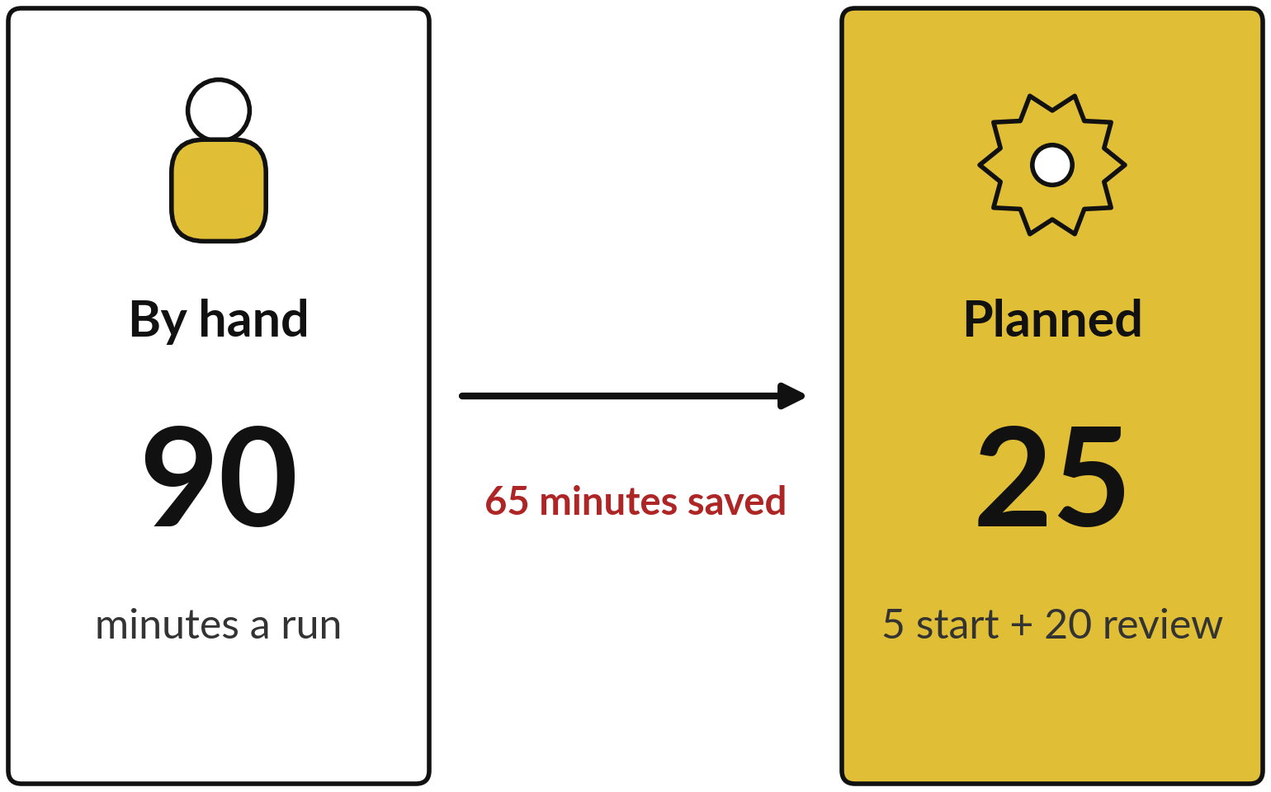
Worked example: the Monday
sales email pays back in 2.8 months
NVF (fictional), 4 runs a month, planned numbers.
Monthly net: UGX 169,000.
12-month net: UGX 1,548,000.
After a 30% haircut: UGX 417,600.
Notes:
The finished NVF example, as in the workbook. By hand, 90 minutes. Planned with the automation, 5 to start and 20 to review, so 25. That saves 65 minutes a run after review. The workbook counts 85 minutes saved before review, then charges the 20 review minutes as a cost.
Net, that is the same 65 you measured. Benefit of UGX 314,000 less cost of UGX 145,000 leaves a monthly net of UGX 169,000. The one-off cost of UGX 480,000 divided by 169,000 is 2.8 months. Twelve months net of the one-off cost: UGX 1,548,000. With a 30 percent haircut: UGX 417,600.
These are planned numbers, and Session 12 shows how they compare with twelve real runs.

Slide 10
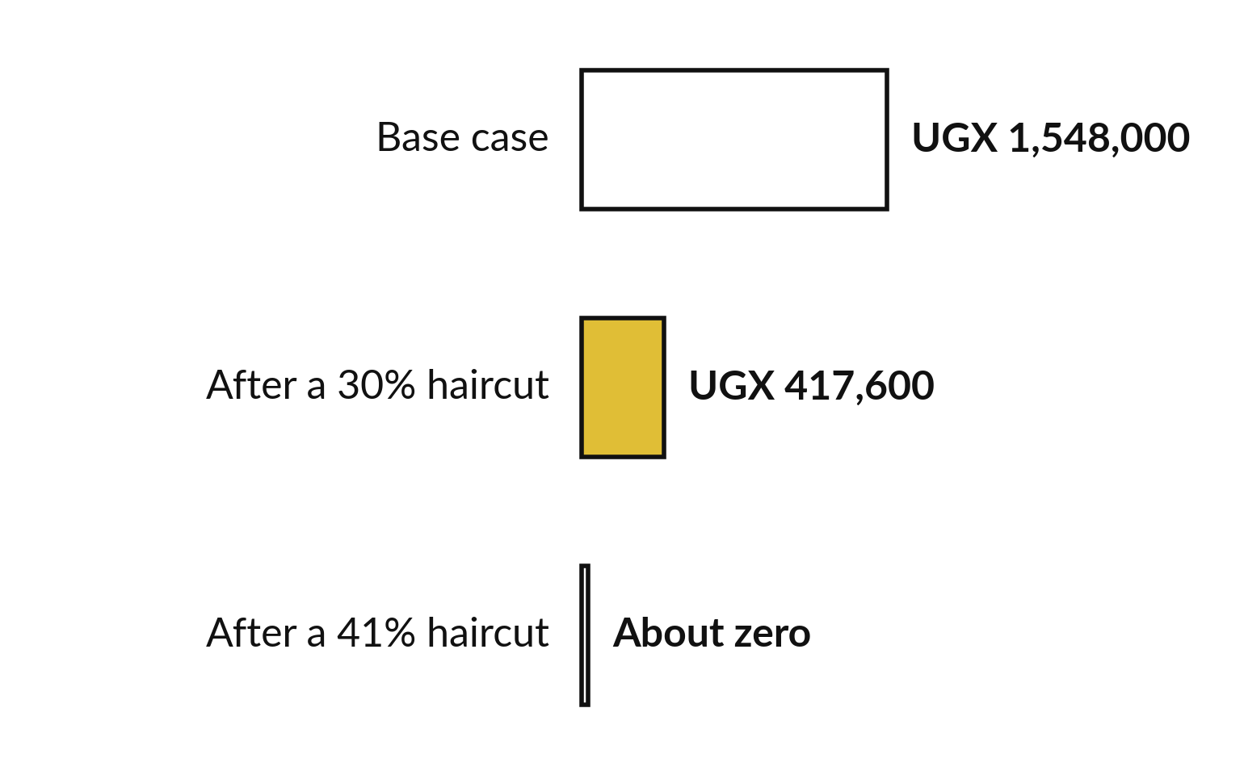
A haircut shows how much
bad luck the case can survive
Ask how much of the benefit can vanish before the case breaks.
The haircut is a share you do not count.
Break-even haircut at NVF: about 41%.
Below zero: improve it, or wait.
Notes:
A haircut is how I stay honest. Estimates are rarely exact, so I choose a share of the benefit not to count. NVF uses thirty percent, which leaves UGX 417,600 over twelve months. The workbook also shows the break-even haircut: the point where the twelve month net reaches zero.
For NVF it is about forty-one percent. That gives the owner of the business a plain sentence: the case holds even if more than a third of the benefit never appears. If your break-even is small, your case is fragile. Thirty percent is a common starting point. Choose your own figure and explain it.

Slide 11



Low, base and high: NVF is positive
in two cases and negative in one
Scenario | What changes | Monthly net | Payback | 12-month net
Low | Volume 70%, saving 60%, errors avoided 40%, costs 30% higher | UGX -76,780 | No payback | UGX -1,545,360
Base | The numbers on your Inputs sheet | UGX 169,000 | 2.8 months | UGX 1,548,000
High | Volume 110%, saving 120%, errors 120%, costs 10% lower | UGX 283,980 | 1.5 months | UGX 2,975,760
Takeaway: a case that is positive in only two of three scenarios needs a stop rule for the low case.
Notes:
This is the Sensitivity sheet with the workbook's default factors. The monthly net is minus UGX 76,780 in the low case, UGX 169,000 in the base case and UGX 283,980 in the high case. In the low case, volume is seventy percent, only sixty percent of the saving happens, only forty percent of errors are removed, and costs are thirty percent higher.
The result is no payback. In the high case it pays back in about a month and a half. The haircut shrinks the benefit; sensitivity changes the assumptions. Use both. NVF is positive in two of three scenarios, so I ask what would have to be true in the low case, and I write it as a stop rule.

Slide 12


Write your stop rules before you start, as numbers
Stop if one error reaches a customer or the bank, until the cause is fixed.
Revise if review minutes rise above 30 a run.
Revise if the 12-month net after the haircut turns negative.
Stop if the saving is under half the plan after four weeks.
Scale only after the base case holds for two months.
Notes:
What would change my mind?
Write it down now, while you are calm. These are example rules for NVF. Stop if one error reaches a customer or the bank. Revise if review minutes climb above thirty a run. Revise if the twelve month net after the haircut turns negative. Stop if the saving after four weeks is under half the plan.
Scale only after the base case holds for two months. Each rule is a number somebody can check. In Session 12 these rules become your day 60 review test, so choose numbers you can read from your own Results Tracker.

Slide 13






People decide whether the
automation succeeds: six plain steps
Tell people early what is coming and why.
Train the people who check the results first.
Name one owner who holds the off switch.
Say what the saved time is for, so jobs feel safe.
Give AI literacy training to everyone who uses the tool.
Give staff one place to report problems.
Notes:
A good business case can still fail because of people. Tell staff early what is coming and why. Train the people who check the results first, because their review time is in your costs. Name one owner, the person accountable for the automation, who holds the off switch.
Say clearly what the saved time is for, for example more customer visits or fewer late nights, so people do not fear for their jobs. Give everyone who uses the tool basic AI literacy. And give staff one place, a person or a shared inbox, to report problems.
Write these into the summary. Now I fill the workbook live so you can see the whole case in one place.

Slide 14
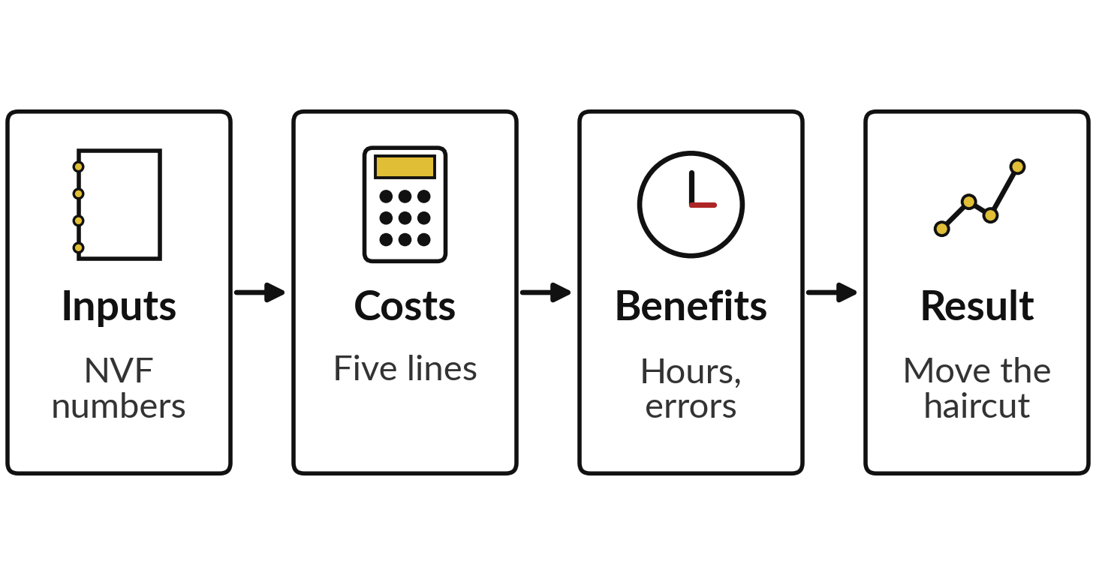
Demonstration: fill the workbook
live, then move the sensitivity
I will show
Watch for
Net 169,000, payback 2.8 months.
The haircut moves only risk-adjusted lines.
At 0.5 the 12-month net turns negative.
Which factor moves the answer most.
Notes:
Now I fill the workbook live with the Nile Valley Foods numbers. Inputs first, then costs, then benefits. Watch the Result sheet: UGX 169,000 net and 2.8 months payback should appear. Then I change the haircut from 0.3 to 0.5 and the twelve month net turns negative. On the Sensitivity sheet I change one factor in the low case, and we see which number the case depends on most.
The four sheets on the left show the order. You check every live result against the numbers you have just seen on the example slides.

Slide 15
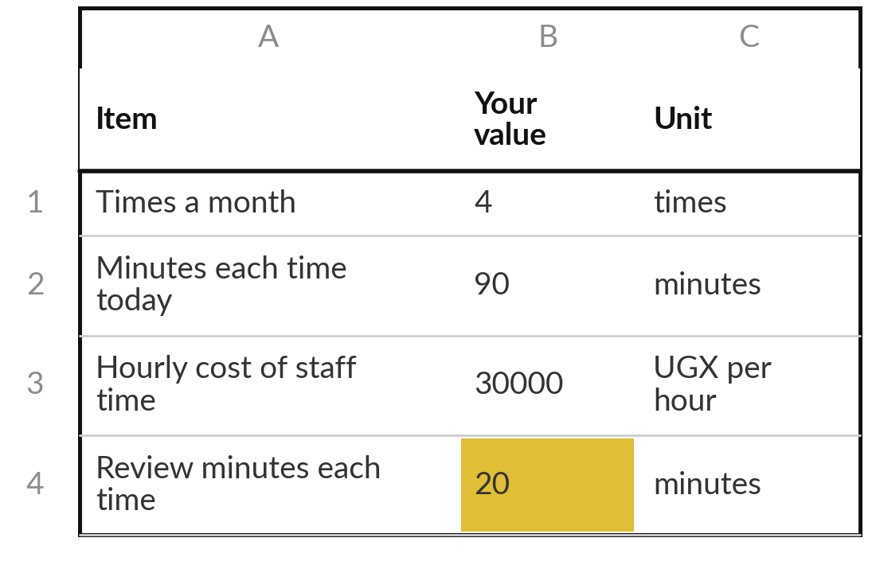
Practice: enter your measured
numbers and your costs
15 minutes
Your own company task
Fill Inputs and Costs in your own Business Case Workbook.
Open Business Case Workbook.xlsx. Type your Session 8 numbers over the grey ones.
Work out your loaded hourly cost. Mark estimates.
Add every cost line. If you buy, use the vendor's first-year total.
Keep review minutes above zero.
You keep: Inputs and Costs sheets filled with your own numbers.
Notes:
Take fifteen minutes. Open the Business Case Workbook and type your own numbers over the grey ones. Take the minutes by hand, the minutes with automation and the review minutes from your Session 8 test log. Take the error rate from your task card. For your loaded hourly cost, add employer contributions and benefits to monthly pay and divide by hours worked.
Then fill every cost line. If you chose to buy or partner, put the vendor's first-year total in the one-off and licence lines. I will walk around. Ask me when a number is an estimate, and mark it as one.

Slide 16
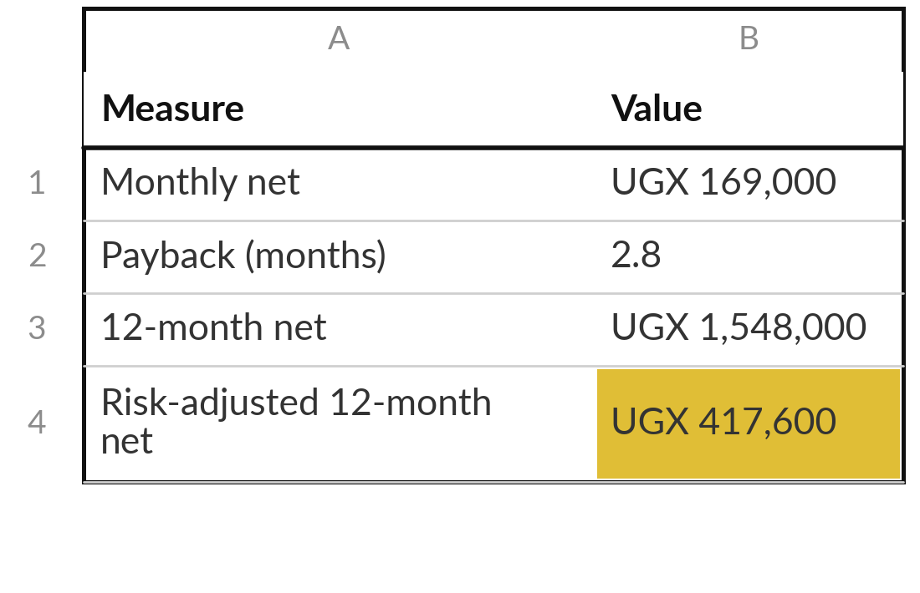
Practice: read the result, apply
a haircut, test three cases
15 minutes
Your own company task
Finish Benefits, Result and Sensitivity, then write three stop rules.
Check Benefits: hours saved and errors avoided. Leave other benefits at 0.
Type your haircut on Result. Note the payback and break-even.
Adjust the low, base and high factors on Sensitivity.
Write three stop rules as numbers.
You keep: Payback, a haircut result, three cases, three stop rules.
Notes:
Another fifteen minutes. Check the Benefits sheet. Hours saved and errors avoided come from your inputs. Leave other benefits at zero unless you can show a number. On the Result sheet, choose a haircut and write down the payback, the twelve month net after the haircut and the break-even haircut.
On Sensitivity, adjust the factors to suit your task. The Base column must match the Result sheet. Then write three stop rules as numbers. If your low case is negative, say so plainly. That is a useful finding, and it tells you which stop rule matters most.

Slide 17
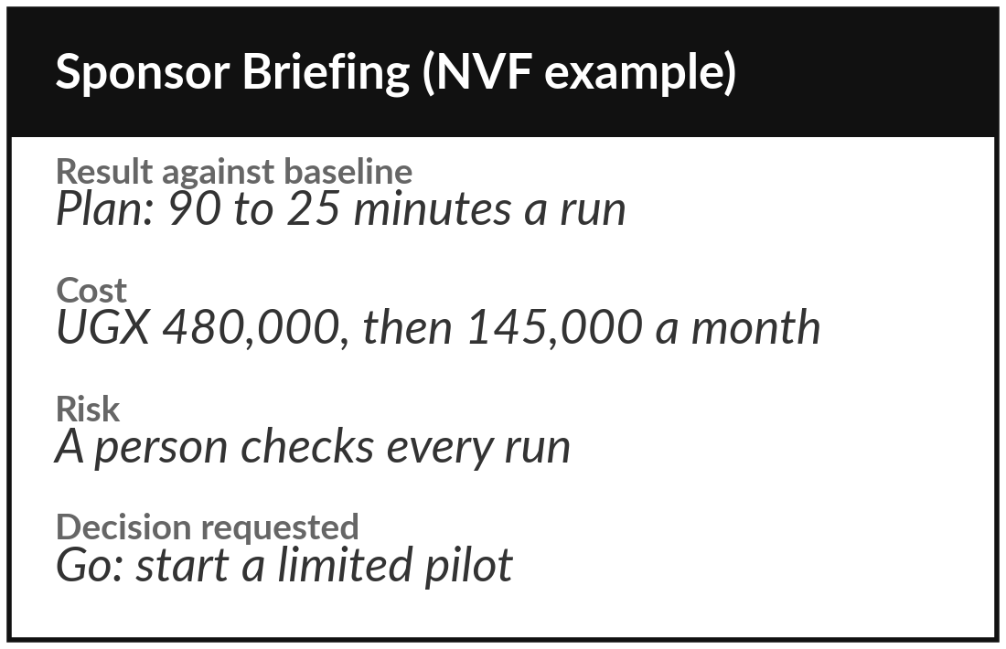
Practice: write the one-page sponsor summary
15 minutes
Your own company task
Summarise your case on one page using Sponsor Briefing.docx.
Name your sponsor: the person who owns the result and asks for the decision.
Fill What we did, Result against baseline, Cost and Risk. Label planned numbers as plan.
Write the decision you ask for in one sentence.
Read it aloud. Can the owner of the business decide in two minutes?
You keep: A one-page summary: result, cost, risk and the decision requested.
Notes:
Last fifteen minutes of your own work. Open the Sponsor Briefing. A sponsor is the person who owns the result and asks for the decision. In a small company that may be you, and the page goes to the owner of the business or the board. Fill it in now with your planned numbers from the workbook, and label them as plan.
At day ninety you replace them with measured figures from the Results Tracker. Fill what we did, result against baseline, cost and risk. Then write one sentence that says what you want decided. Read it aloud. If it takes more than two minutes, cut it.

Slide 18



Decision: go, revise or stop for your own task?
What do you decide, and which number decided it?
Go
Revise
Stop
Positive after the haircut and in at least two scenarios. Start a limited pilot with a review date.
Positive only in the base case. Fix the weakest number: review time, error cost or price.
Negative after the haircut and in every case. Keep the workbook and retest when a number changes.
Write the decision and the one number that decided it on the summary page.
Notes:
Time to decide. Go means the case is positive after the haircut and in at least two of the three scenarios. Start a limited pilot with a review date. Revise means it is positive only in the base case, so fix the weakest number: review time, error cost or the tool price.
Stop means it is negative after the haircut, so keep the workbook and test again when a number changes. A stop with a clear reason also saves money. Write your decision and the one number that decided it. That number is what you lead with in Session 12.

Slide 19
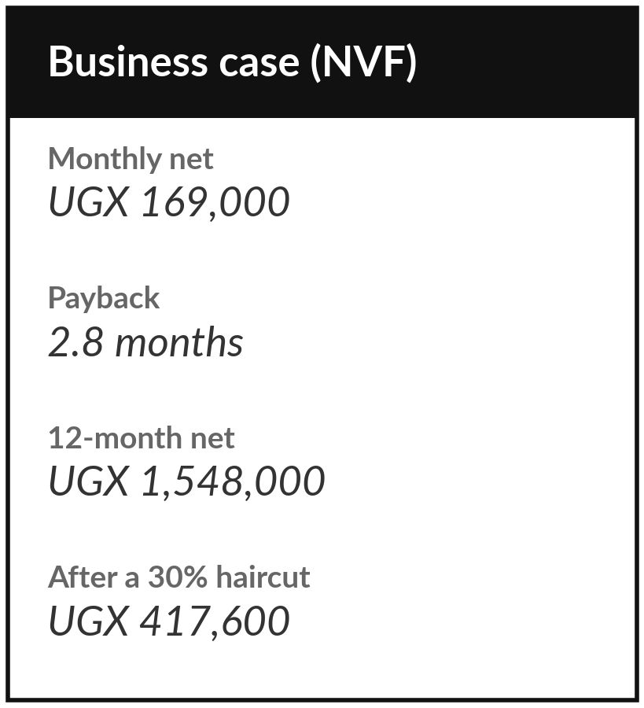
Save it, and bring one question to the next session
What you keep from today
Your costed Business Case Workbook and a one-page Sponsor Briefing, with your go, revise or stop decision and the number that decided it.
Our question today
Is it worth doing, and what would change my mind?
Next session
Session 12: Demo day and your 90-day roadmap. You will present your result and plan the next 90 days.
Notes:
Save the workbook and the summary page in the same folder as your task card and test log. Next session is demo day. You present your task, your result and your business case in eight minutes, so bring the workbook and one slide or page that shows the numbers.
Optional, if you want a head start: write down the one number that would make your sponsor say yes or no. That is your question for Session 12.
We began with this question: Is it worth doing, and what would change my mind? Before you go, say in one sentence what you can now say about it.

